Slide 1

State of the Marketplace November 5, 2020
Susan Blankenburg, General Manager, FAIRA
Ryan Jacques, Vice President – Arthur J. Gallagher & Co.

Slide 2
Introduction
2020 The most challenging year the Insurance Industry has faced in 15 years
          Social inflation, low interest rates, catastrophic losses
Before the Corona Virus hit rates were hardening
          10 years of rate reductions
          Eroding carrier profits
          Low to no investment income
          Increased losses: Law Enforcement, Employment Practices, Wild Fires, Hurricanes, Tornadoes, grounding of Boeing 737 MAX…
COVID-19 had a huge financial impact on Government
          Average budget and revenue reductions of 20-30%
          Estimations of immediate impact are $50-80 billion in claims
          Uncertainty of when we will have a Vaccine
  “We are still in the middle of a crisis and have yet to see
  what the second and third waves will do.”

Slide 3
Introduction
Social Inflation is a major contribution
          “Social inflation is one of the latest buzzwords in insurance. It describes the rising claims costs resulting from things like increasing litigation, broader definitions of liability, more plaintiff-friendly legal decisions, and larger compensatory jury awards.”
          “Social inflation comes from a number of things, including how juries are composed these days. The jury composition impacts the outcomes of verdicts in a big way.”
          “The biproduct of this is something that’s always existed, but seems magnified now, which is the targeting of large corporate risks and governmental agencies.”
          “Over the past few years it has worsened while plaintiff bars develop psychology-based strategies to trigger juries.”
          “Studies have shown plaintiff awards above $5 million have increased at a rapid pace over last years.”

Slide 4
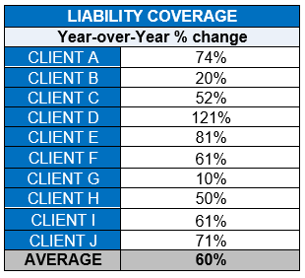
Liability Insurance
          Average US increase 21% - the largest increase since 2012
          Average renewal increase with Police, Fire & Public Works 60%
          Median average Verdict for top 50 cases doubled
          Issues:
          Claims severity with Multi-million dollar settlements by sympathetic juries and no Tort Reform expected
          Law Enforcement Liability
            Carriers non-renew writing LEL
    Mandatory $5 million minimum LEL SIR
    Carriers price based on worst case scenario and predict the worse verdict.
    George Floyd
    Jacob Blake
    Breonna Taylor
60%
average increase for
Public Entity Liability
as of July 2020

Slide 5
Liability Insurance
          Employment Practice Liability claim’s on the rise
    Layoffs and reductions in work hours due to budget cuts from COVID
    #Me Too movement
    Rise in employee activism – equal pay, workplace harassment
          Sexual Abuse/Molestation coverage is almost non-existent
    AB 218 allows victims of child abuse up to age 40 to file
          Push for Qualified Immunity to bring suits against Police Officers
    Civil charges to be brought against officers’ personally, for excessive force and misconduct.
          Start the renewal process early 60-90 days before quote due date
          Carriers will prioritize submissions
          Deliver quality submissions
    Full loss details
    Listing of all Law Enforcement trainings, such as: Excessive Force, high speed chases,
    policy on choke holds and Employment Practices and Harassment trainings.

Slide 6
Automobile Liability
          Automobile Liability – Minimum US Increase 7-20%
          Loss leaders:
    Distracted driving
    High speed chases
    Drivers asleep at the wheel
    Mechanical fires
          Automobile PD – 10-25%
          Increased cost to repair/replace municipal vehicles with modern technologies as cameras, radios, computers and other expensive electronics.
    Fire engines, paramedic vans, hazmat fire truck, water tender, bull dozers
          Few carriers interested in writing new business
    Auto PD marketplace restricting from 3 or 4 markets down to 3 or 2
    One major Auto PD player – exited the marketplace in 2020

Slide 7
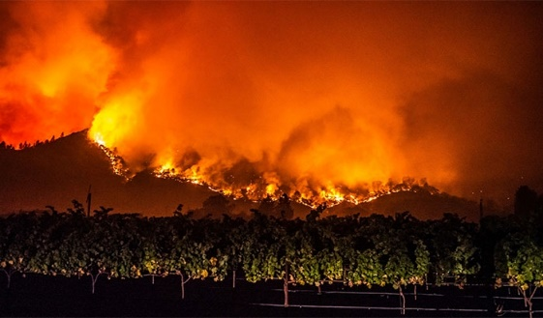
Property, Earthmovement & Flood (DIC)
          85% of clients see increases in rate
          Public sector rates increase, with 20% being the average
          Rate increases based on losses, construction and valuations
          2020 Wildfires set new records burning 4 million acres, up from 2 million in 2018.
          About $18 billion in costs
          Major carriers abandon the marketplace
          Others reduce limits and increase deductibles
          Reduce and/or eliminate sublimits
          Communicable Disease coverage is deleted or limited
          Best results included a limit down from $1 million to $100,000

Slide 8
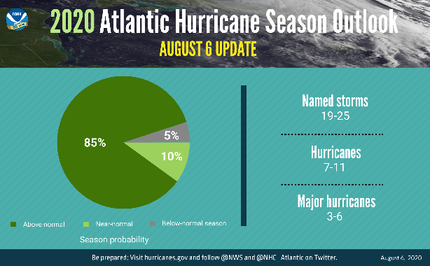
Property, Earthmovement & Flood (DIC)
          Climate Prediction Center forecasts an extremely active Hurricane season
          Most active in 22 years
          Same carriers and reinsurers who write accounts with Fire, EM & Flood also write Hurricane and Tornado coverage
          Adverse loss results to a book of business affects all policyholders
          Carriers are buried with submissions
          Start early
          Deliver quality submissions
          Insurers reaching and exceeding budgets and have no hunger to write new business.

Slide 9
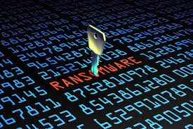
Cyber Risk-Privacy Liability
          Average US increase 5-20%
          Marketplace has hardened with the increase in ransomware claims in 2019 into 2020
          Ransomware severity losses jump from $500,000 average in 2019 to $1,000,000 in 2020.
          Carriers are increasing most deductibles under $100,000
          Larger increases will be imposed for accounts with loss activity

Slide 10
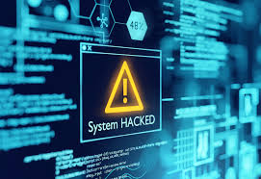
Cyber Risk-Privacy Liability
          COVID-19 and the remote workforce trigger an increase in losses
          Insecure Wi-Fi networks
          Use of personal devices
          Video conferencing platforms open to cyber attacks
          There is evidence of COVID-19 themed criminals
          Amble carriers interested in quoting
          Start early
          Deliver quality submissions
          Provide detail on training
          Internal protocols to keep network safe
          Complete details on breaches and ransomware attacks

Slide 11
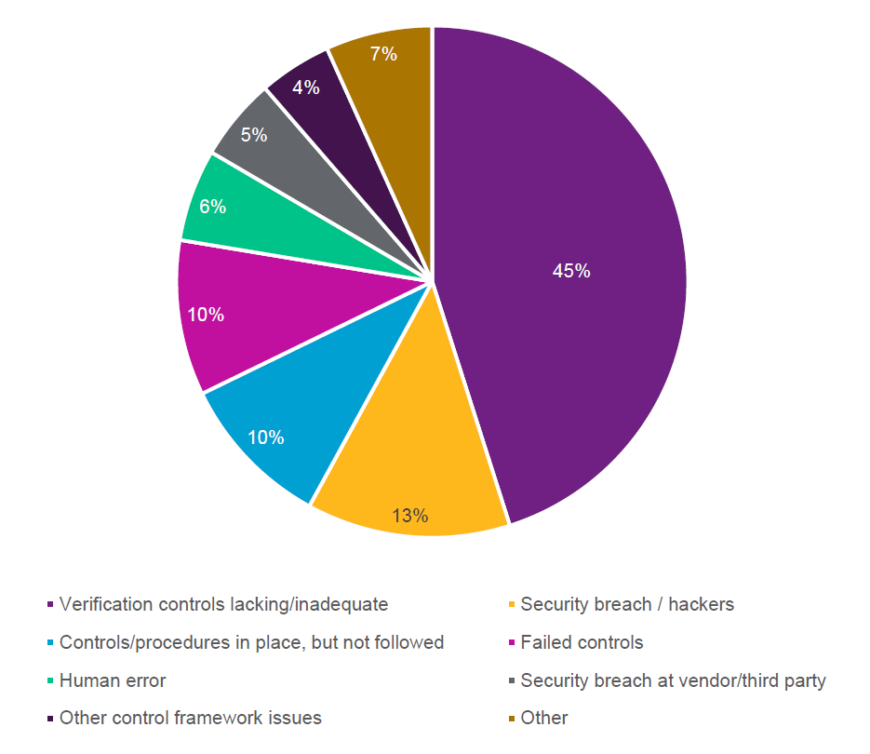
Crime
          Relatively flat to low level increases
          Heightened awareness is drawn to Crime losses with “Imposter Fraud” aka “Deception Fraud” or “Social Engineering.”
          Fake President, CEO or CFO email scams
          Phishing and Whale Phishing
          Spoofing
          FBI data shows worldwide email scams
          reached $26 billion over last 3 years
          The first line of defense:
          Verify changes in vendor payment two-factors authentication
          Beware of sudden changes in business practice
          Report and delete unsolicited email from
          unknown parties
          Confirm requests for transfer of funds
          Know your service providers

Slide 12
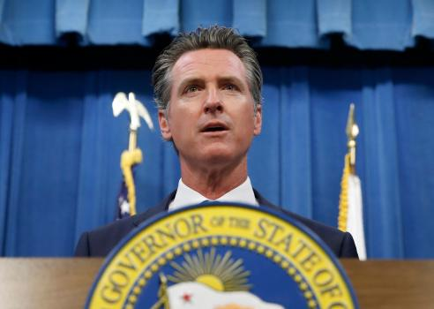
Excess Workers’ Compensation
          Overall costs have increased slightly
          Slight reductions in workforce, payrolls should reduce losses
          First quarter results show -1.25% rate reduction
          Increased exposure for healthcare, construction, food and agriculture workers
          Extension of presumptions for all employees to include losses from
          the Pandemic
          Cost $1-80 billion US
          Cost $2-34 billion (for CA which represents approx. 20% of written premium)
          Too many variables to predict impact of COVID-19 on Insurance Industry
          Few Workers’ Compensation COVID-19 Claims to date
          Single largest claim we have seen for a client was $500,000 for an employee on respirator in ICU
          Handful of other claims with low reserves
          Excess Workers’ Compensation is largely loss rated
          Good news for many!

Slide 13
Questions?
Closing Comments

